Slide 1
Week 3
Brittany Marietta
Jesse jento
Trey brown
Michael cheng

Slide 2
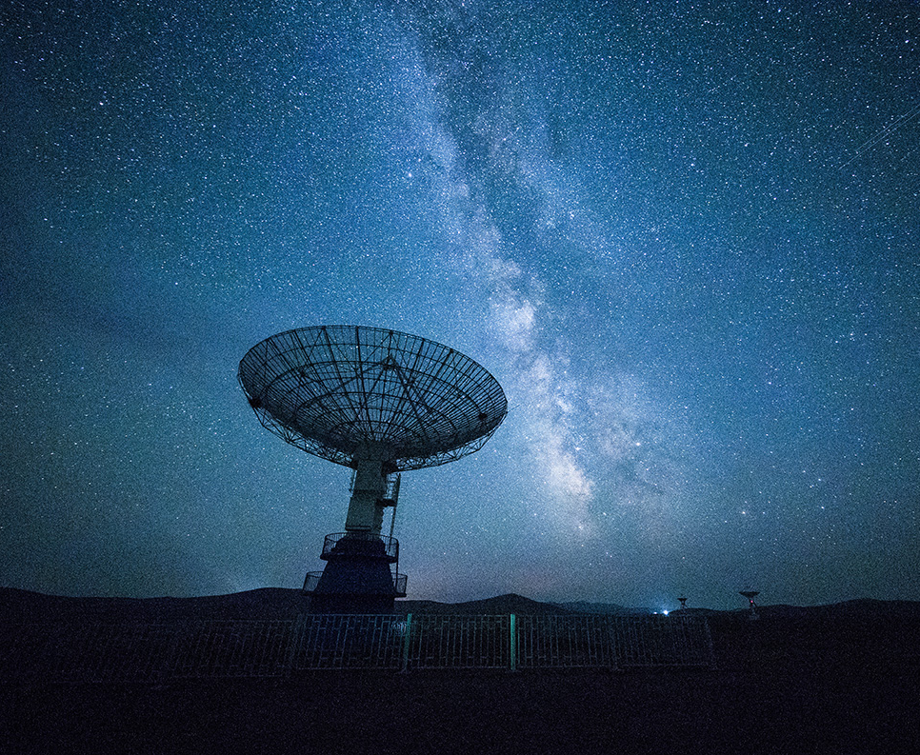
Login page

Slide 3
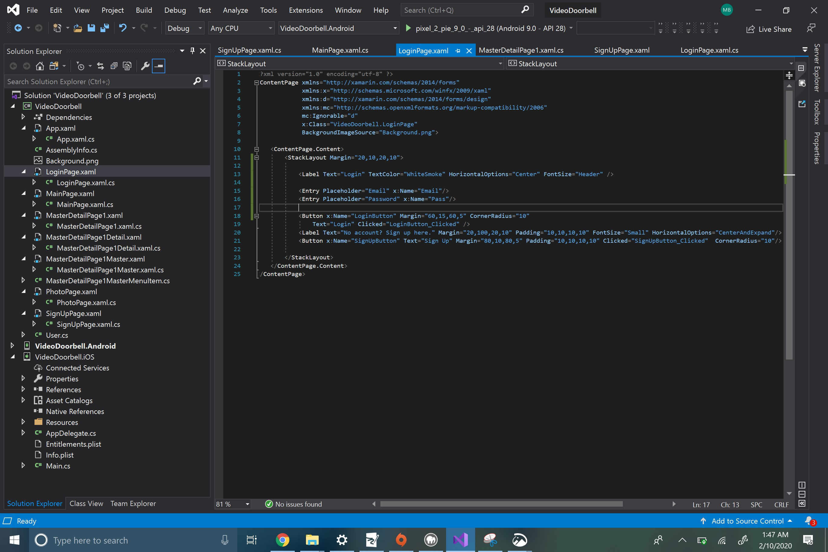
Login Page

Slide 4
Sign up Page

Slide 5
Sign UP Page

